Slide 1
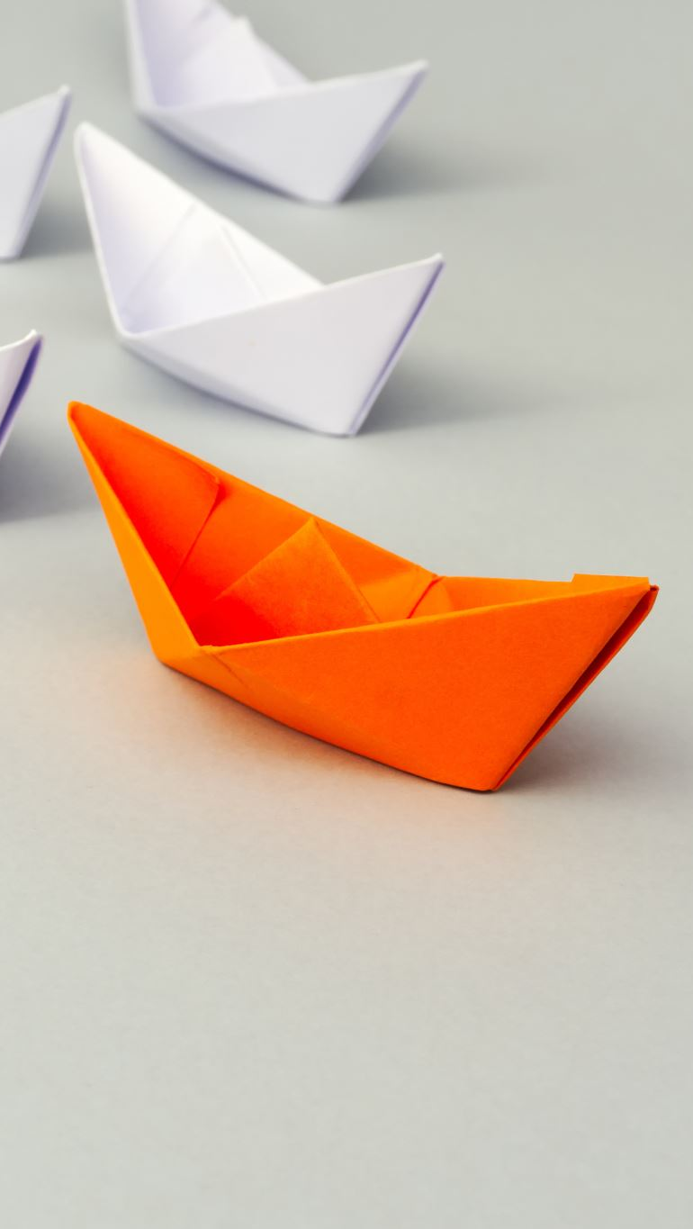

Waterfront Recreation Sites in Philly
CPLN 680 Capstone
Rui Jiang

Slide 2
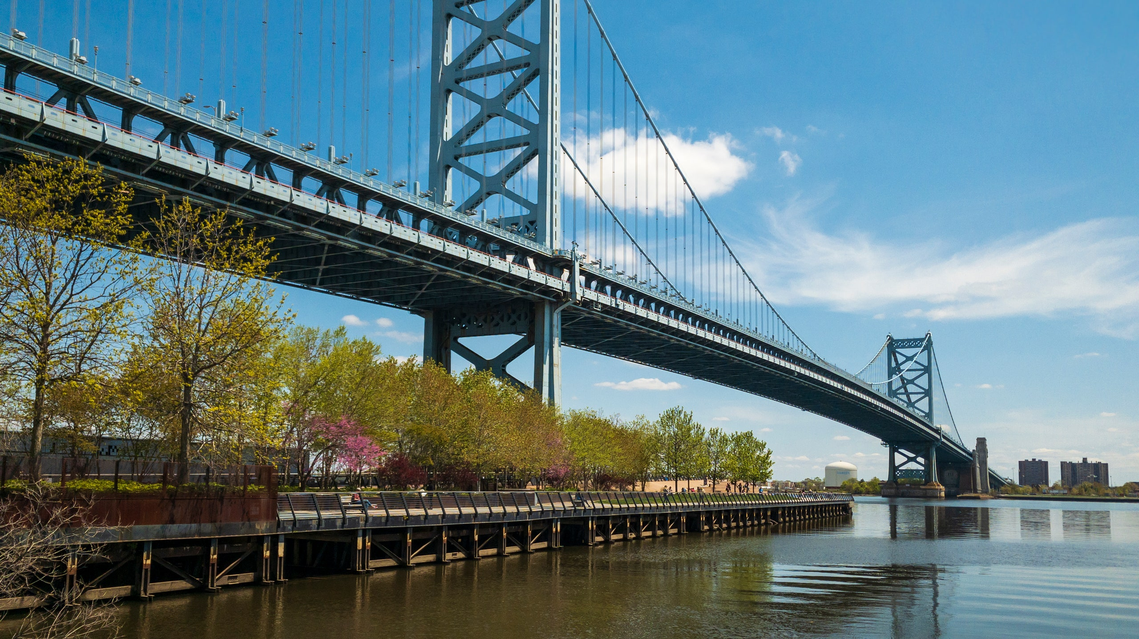



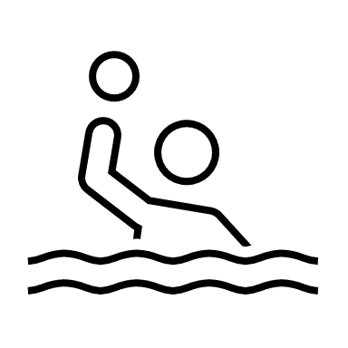
Background Delaware River
serves fifteen million people for drinking, fishing, kayaking, and other recreation
a 27-mile stretch of the river needs improvement
is considered safe for only secondary contact recreation for all time (no immersion & ingestion)

Slide 3


Motivation
Find the potential for waterfront recreation under the current situation and help adjacent communities be informed on the fairest opportunities to access recreational activities for each resident in the safest possible way
Find out the factors people would take in consideration when choose waterfront recreational sites
Make list of factors that will influence the visiting experience but not be take in consideration in the previous steps
Make a dashboard that works both in computer and phone for users to use in different usage scenarios

Slide 4
Process & Data
List factors
Finding data
Research on factors
Doing Analysis
Find platform
organize information
including other useful websites
Conclusion
report & dashboard

Slide 5
Work in progress
List factors
Finding data – precipitation accumulation, CSO overflow, wind speed, temperature, air quality, recreational use categories
Find platform
“Introduction” page and “Plan your visit” page
including other useful websites – CSOcast & RiverCast

Slide 6
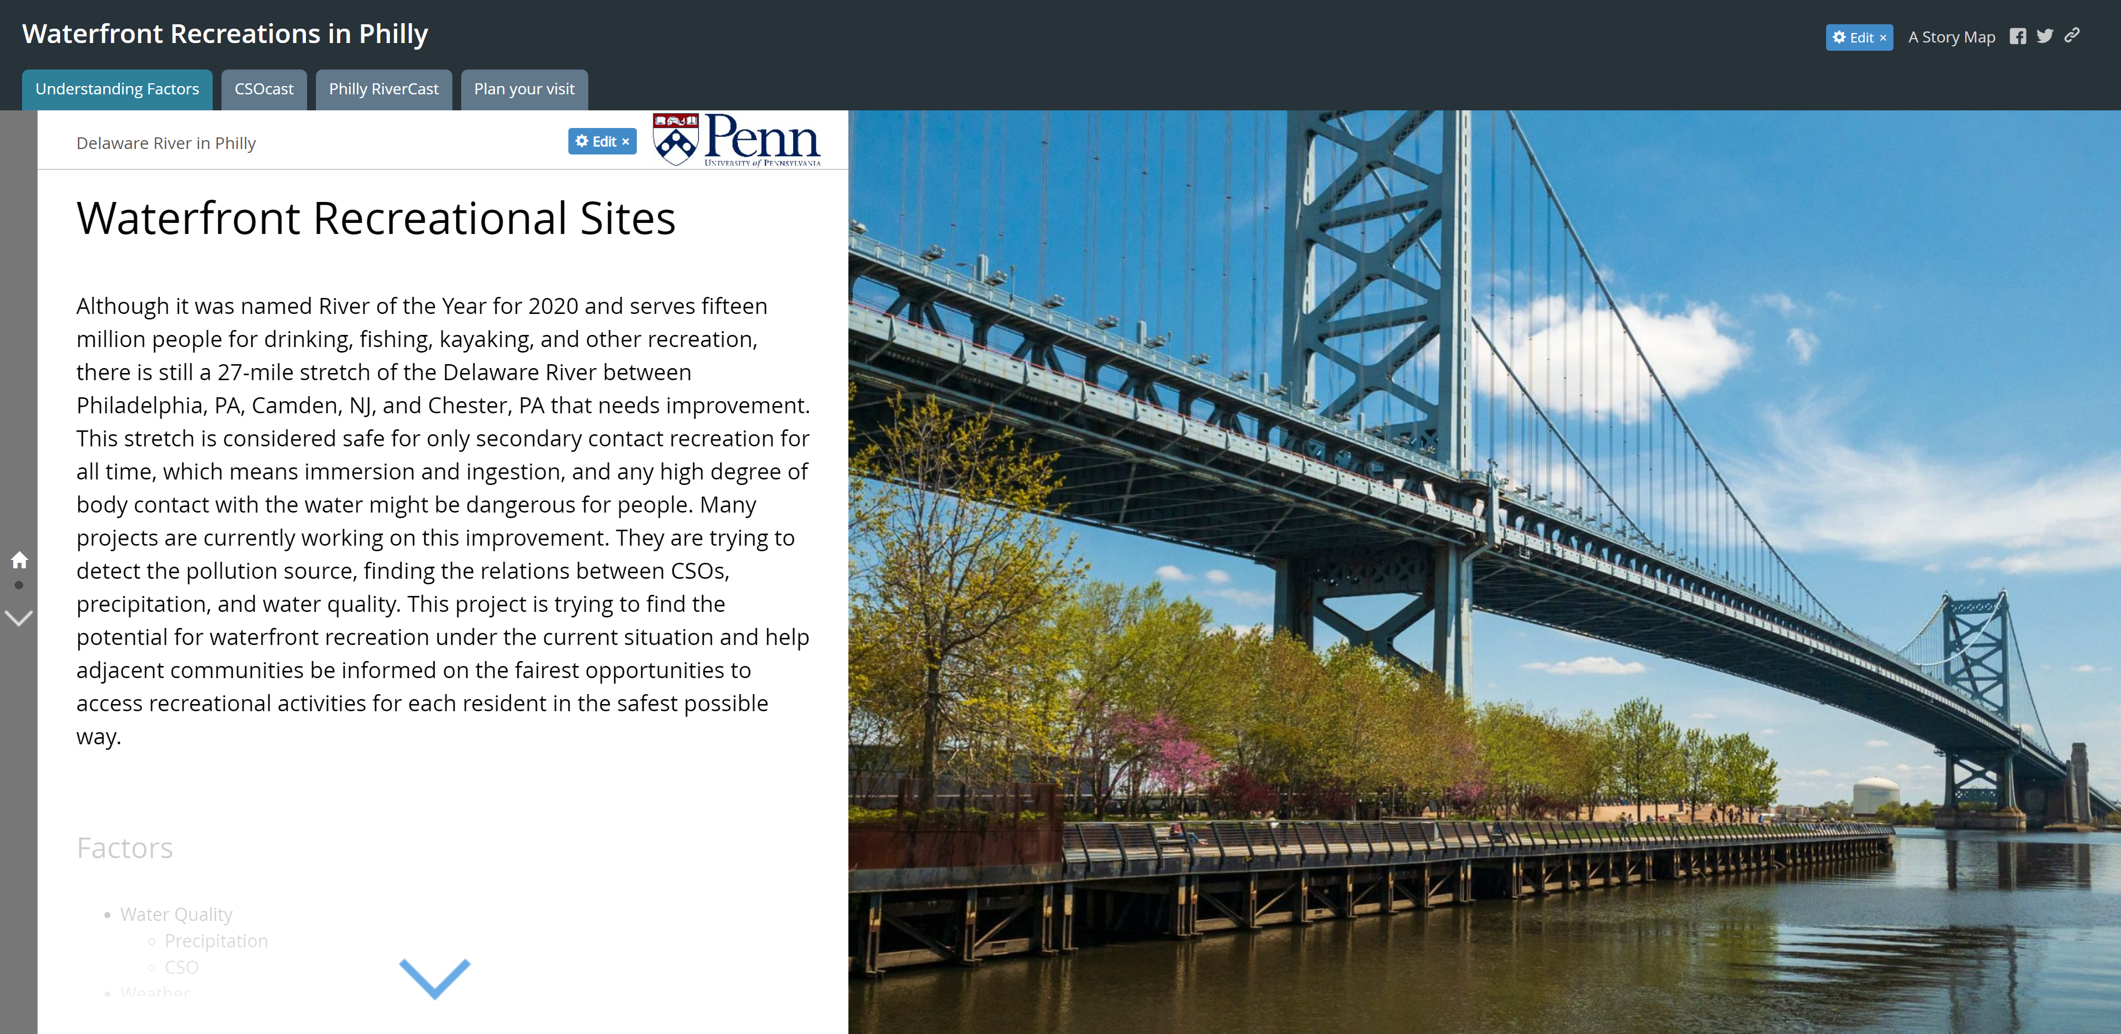

Slide 7
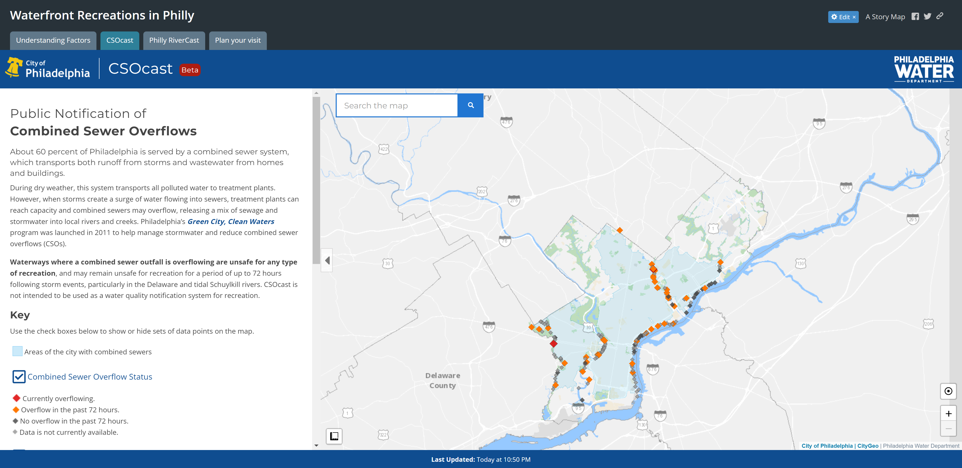

Slide 8
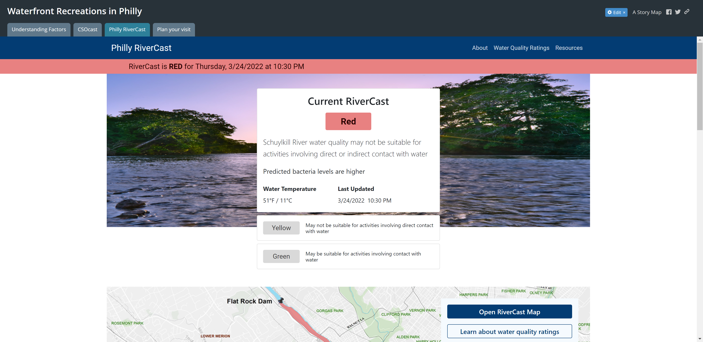

Slide 9
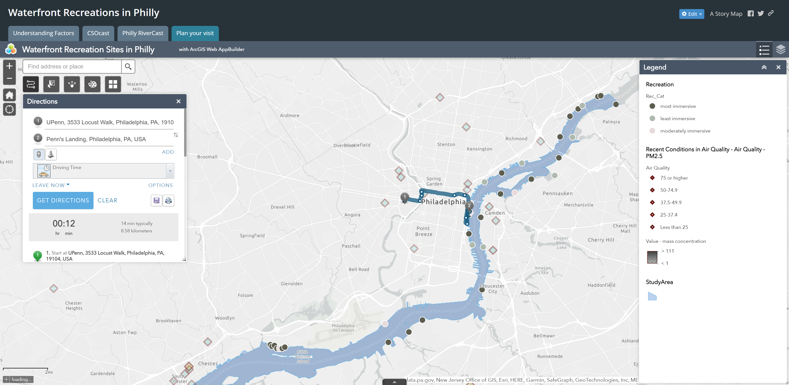

Slide 10
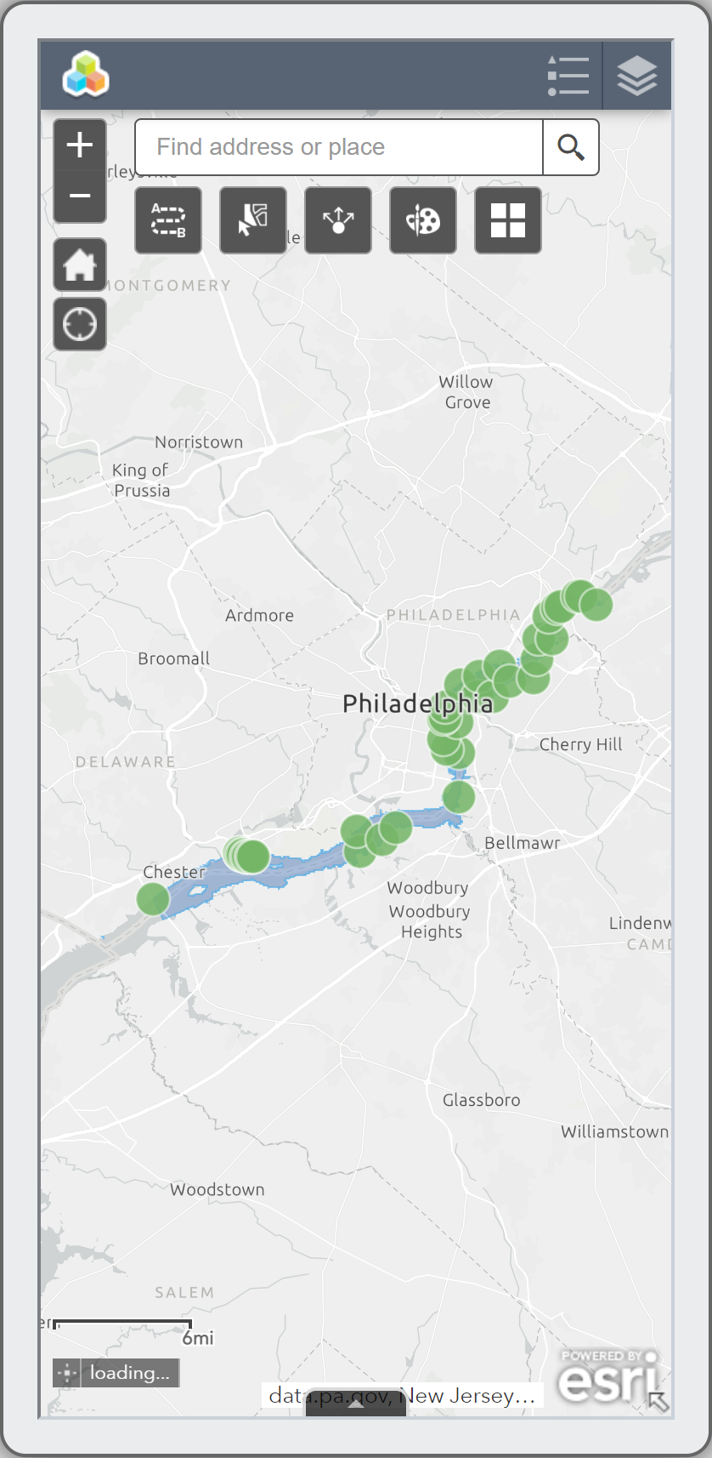
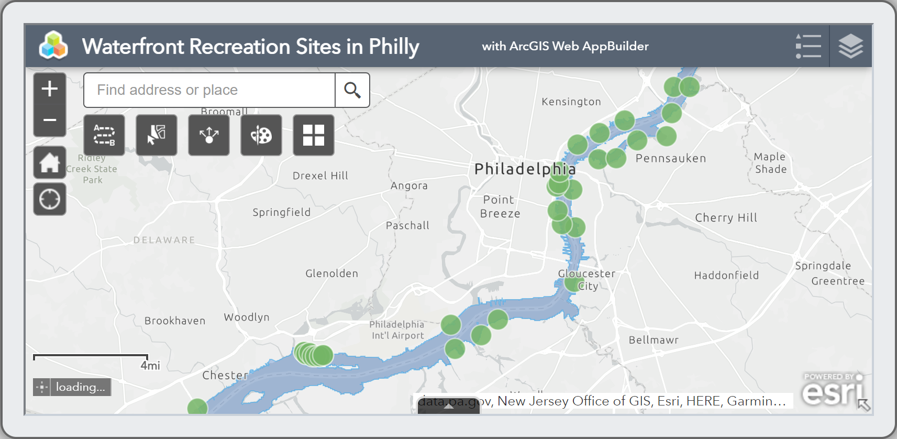
Phone View

Slide 11
Next Step
Research on factors
Doing Analysis – how each factor influence people’s plan or experience, why some factors (that people not usually think of) are important for resident’s safety
ESRI Web APP
“Introduction” page – clearly explain the analysis to users
“Plan your visit” page – fully build up the Web APP to navigate users
including other useful websites – besides CSOcast & RiverCast

Slide 12
Thank you

